Slide 1
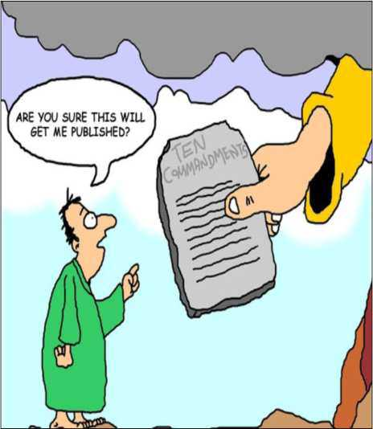
Writing for Publication
DoD/MAMC Clinical Informatics Fellowship

Slide 2
Objectives
Provide overview on scholarly activity
Boyer’s take on scholarly activity/scholarship
Questions to ask yourself
Review ten steps for publication
Discuss the “Be’s”
Review writing styles
Cover use of jargon, abbreviations and acronyms

Slide 3

Overview
Scholarly activity is a common program requirement for accreditation by the Accreditation Council for Graduate Medical Education (ACGME) for all specialties
There is no uniform way to assess scholarly activity of faculty and fellows

Slide 4
Boyer
Boyer sought to give ‘scholarship’ a broader meaning that brings legitimacy to the full scope of academic work.
This is applicable to the development of a definition of scholarly activity in graduate medical education.
Boyer’s pivotal work lays out the 4 components of scholarship: discovery, integration, application, and teaching

Slide 5
Why Bother?
Too much of the Informatics literature is filled with bench-type research that is not applicable to end users and patients…at least not yet
That means the literature needs more applied informatics knowledge that comes from people like us
Because of our ability to work with end users directly, and to extract data from the new EHR in a more robust fashion, we can offer significant insight into how the EHR affects quality, safety and outcomes
We can also offer insight in how to adjust workflows, training and other end user-focused components to positively affect those outcomes

Slide 6
Four Questions to Ask Yourself
Why do you want to publish on a topic?
Why do you want to publish it now?
What does it have to do with you or your expected audience?
Will it be worth the audience member’s time to read it?

Slide 7

Where to Start? Step 1 – Choose Your Topic
What makes a good topic?
Relevance to today’s practice
Immediacy (good to know about it now)
Impact (it will change what they do)
Teaching value (there is a knowledge gap)

Slide 8
Step 2 – Research your Target Publication
Look at recent issues of the journal(s) you are targeting
Notice the types of articles that appear
Read some of the articles in depth to better understand the style and content
Notice the tone and style
Notice the article length
Does the journal include a lot of accessories?
Read the author guidelines

Slide 9
Step 3 – Understand the writing process
Choose a topic and develop a schedule
Do your research
Organize your article summaries using Endnote
Organize your information and write an outline
You can use Endnote to help build out the outline with automatic citation inclusion
From this, build your rough draft
Let the rough draft sit for a week or so

Slide 10
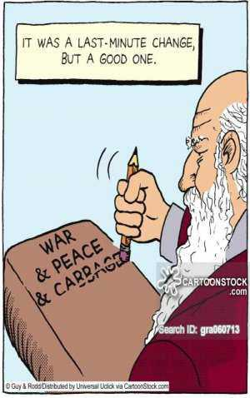
Step 3 – Understand the writing process - cont
Revise the rough draft into a pre-finished version
Proofread it, then have someone else you trust also proofread it
Have someone whose opinion you trust read it and suggest revisions
Revise and finalize the article
Proofread it one last time

Slide 11
Step 4 – Avoid Plagiarism
You are plagiarizing if you fail to adequately acknowledge when you use others’ ideas, words, lines of thinking, etc.
If you include something with exact words, you much include quotation marks around it
Most plagiarism occurs by accident
Some strategies:
When paraphrasing, make sure to put the information entirely in your own words
Check your paraphrase against to the original to ensure you have not accidentally copied words or phrases

Slide 12
Step 5 – Follow Author Guidelines
Always read and understand the author guidelines for the publication
If there is anything you do not understand, ask a fried or contact the publication for clarification
Make sure you are in compliance before you send it to the editor…even for the first submission
If necessary, have someone else read the author guidelines and your article for a sanity check

Slide 13
Step 6 – Navigate the Peer Review Process
You do not have to make every change reviewers suggest
Sometimes peer reviewers are just wrong, and sometimes there comment are not helpful
Make changes that are reasonable and c/w your purpose in writing the article
You must explain to the editor any changes you have chosen not to make

Slide 14
Step 7 – Be Prepared to Revise
Almost all authors in any journal are asked to make revisions based on peer reviewer comments
Do not take it personally or get defensive
As above, you do not have to agree with all the suggested changes
If you feel strongly about some peer reviewer comments, ask the editor about ignoring them
If the editor says you must change based on peer reviewer comments, you have to decide just how strongly you feel about them

Slide 15
Step 8 – Expect the Manuscript to Change
This inevitably occurs during the editing process
The less well written the manuscript, the more it will change as it is edited
Even well written manuscripts usually change to meet the style, needs and format of the publication…and the personal biases of the editor

Slide 16
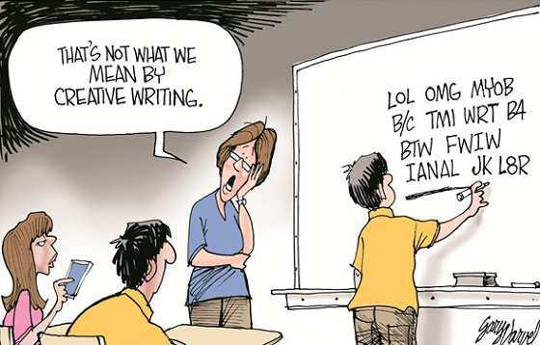
Step 9 – Be a Responsive and Responsible Author
Learn as much as possible about the publication’s production process and deadlines
When the editorial staff asks you to do something, do it quickly, fully and without complaint

Slide 17
The “Be’s”
Be original
Be honest
Be innovative
Be organized
Be careful
Be clear
Be modest
Be fair-minded
Be frank
Be persistent
Be rigorous
Be realistic

Slide 18
Writing Styles
The best scholarly writing communicates complex ideas in a straightforward, clear and elegant manner
If your intended audience is clinical, clear language and direct messaging are especially important
Avoid jargon and long words or those with unclear meaning
The principles for readability are the same as those that used already for patient information leaflets and health education materials
As a general rule of thumb, write in the first person

Slide 19
Writing Styles cont
Using the active voice creates better clarity and flow of your ideas than does overuse of the passive voice
It is best to avoid stereotyping with gender-specific language
Use the plural to avoid frequent use of his/her and he/she, as well as the overuse of “the”
Ensure there is consistency in your use of singular or plural nouns
If multiple authors, be careful to write in the first person plural rather than singular

Slide 20
Jargon and Abbreviations/Acronyms
One person’s jargon is another person’s specialist, technical language
Know your audience to avoid jargon…if your audience is made up of peers, it is no longer jargon
If you are writing for a journal with a peer audience attempting to be overly simplistic may detract from the quality of your content
Explain abbreviations and acronyms the first time you use them
Ways of expressing ideas that are commonplace to you, in your region, may not be self-evident to others, even within a specialty field

Slide 21
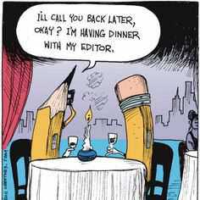
Questions

